Slide 1
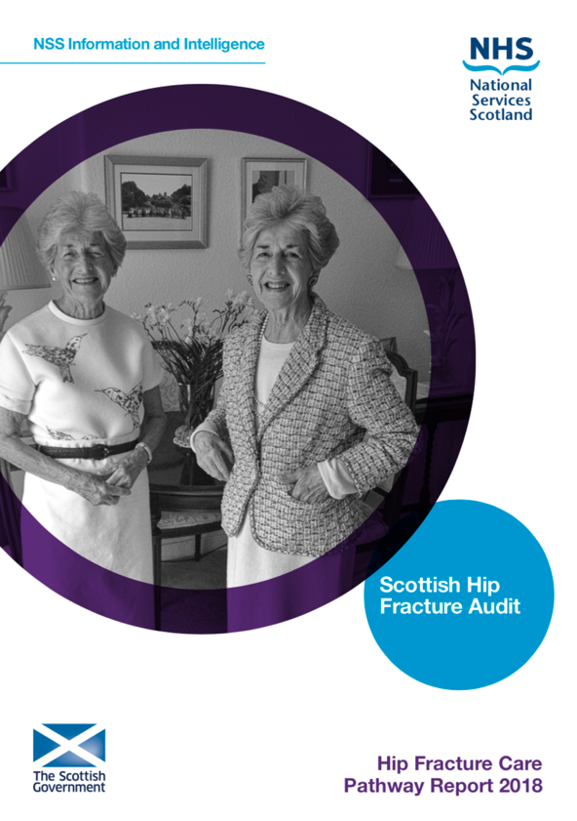
The Scottish Hip Fracture Audit
Mr. Graeme Holt
NHS Ayrshire and Arran
#ScotHipAudit
www.shfa.scot.nhs.uk

Slide 2
Hip Fractures: A Scottish perspective
22 cases per day.
140 000 NHS bed days per year.
£200 million care cost per annum.
More bed days than MI/CVA combined.
>85% of total cost of all fragility fractures.
2
Notes:
2

Slide 3
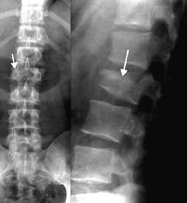
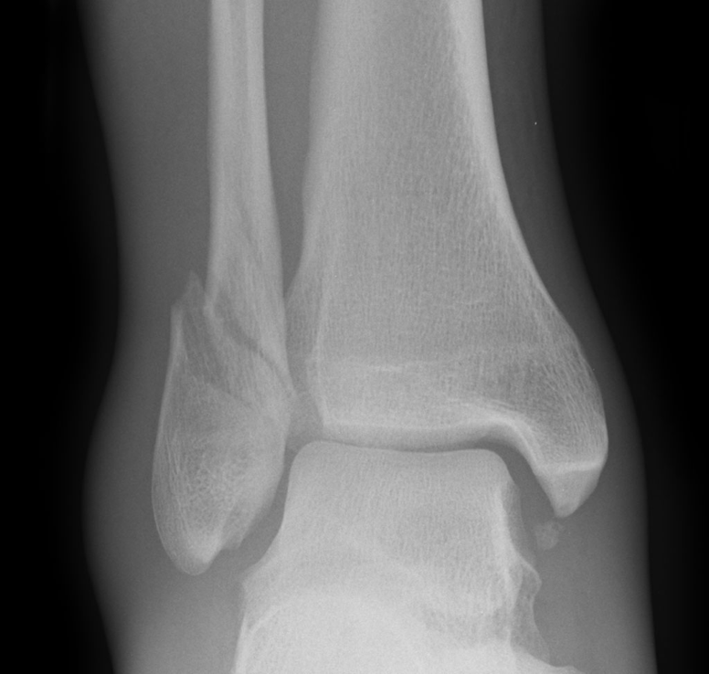
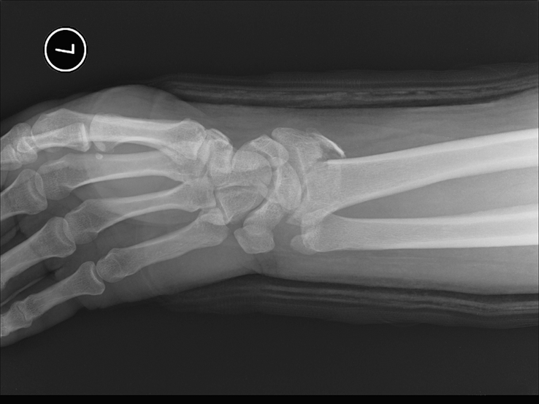
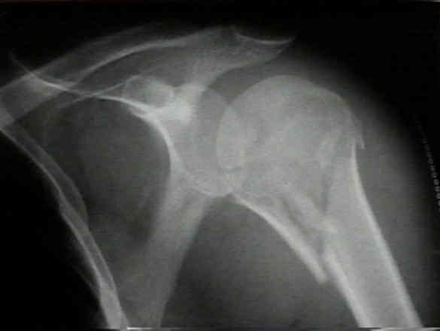
Why audit hip fractures?

Slide 4
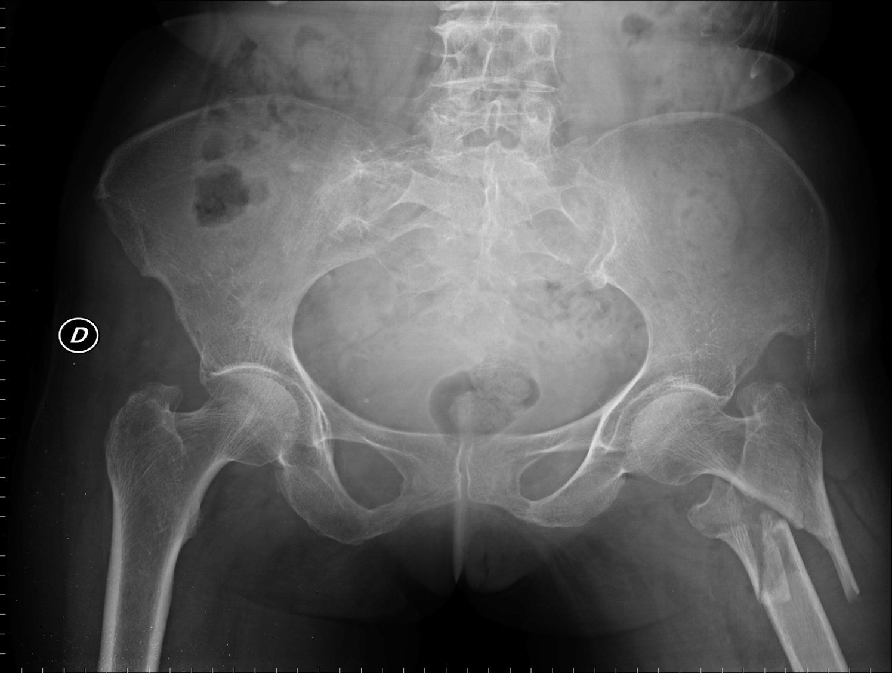
Hip Fracture – “A Tracer Condition for Multi-disciplinary Care” JD Hutchison
GP
SALT
A & E
Paramedics
TSSU
Occupational therapists
Anaesthetics
Nursing Staff
Acute Medicine
Porters
Care of the elderly
Radiographers
Family/Carers
Social services
Theatre staff
Physiotherapists
Orthopaedic surgeon

Slide 5
The incidence of hip fracture has fallen consistently over the last 16 years in the female population.
This is likely due to bone health interventions.
Male incidence is unchanged.
Despite fall in incidence the number of hip fractures has actually increased by 10% since 1999.
Further significant increase will occur from 2018 onwards.

Slide 6
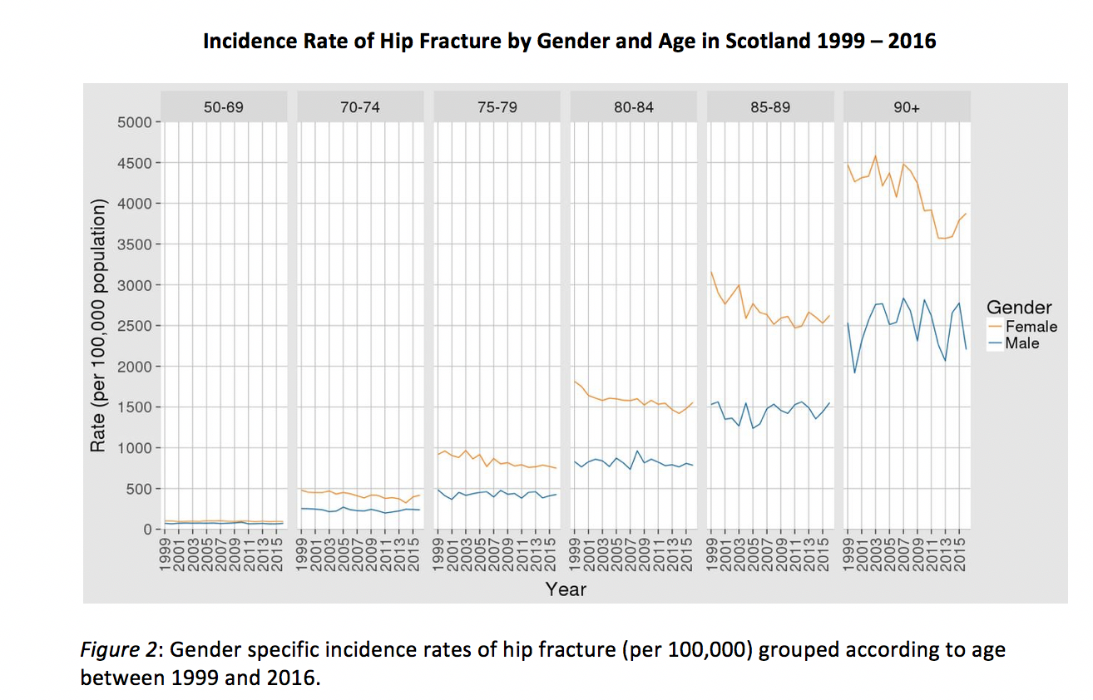

Slide 7
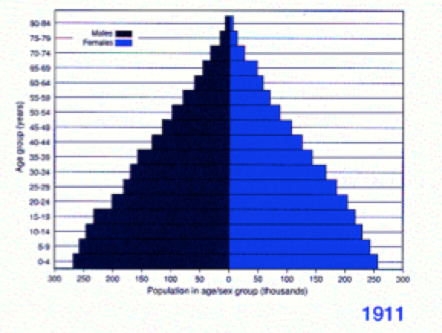
Scottish population 1911 - 2031
Notes:
Typical animal population has triangle age distribution as in 1911. Humans now live too long and don’t breed enough!!!

Slide 8
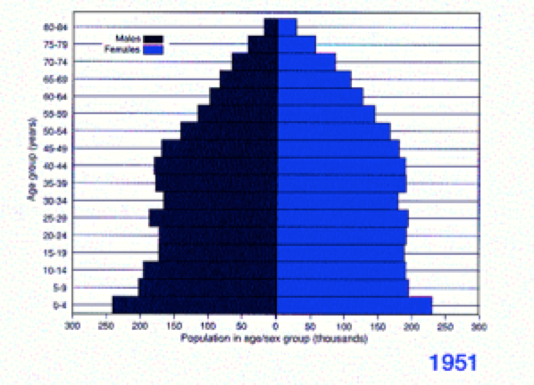
Scottish population 1911 - 2031
Notes:
Typical animal population has triangle age distribution as in 1911. Humans now live too long and don’t breed enough!!!

Slide 9
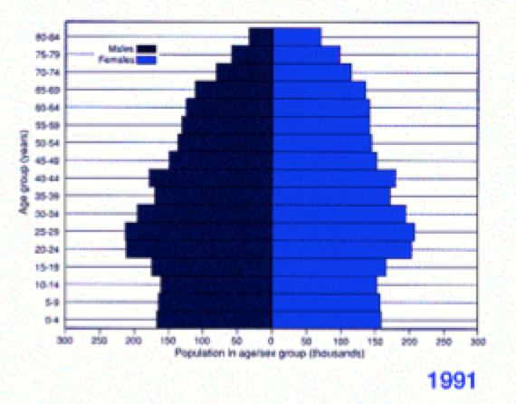
Scottish population 1911 - 2031
Notes:
Typical animal population has triangle age distribution as in 1911. Humans now live too long and don’t breed enough!!!

Slide 10
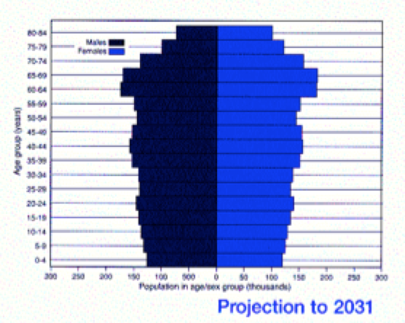
Scottish population 1911 - 2031
Notes:
Typical animal population has triangle age distribution as in 1911. Humans now live too long and don’t breed enough!!!

Slide 11
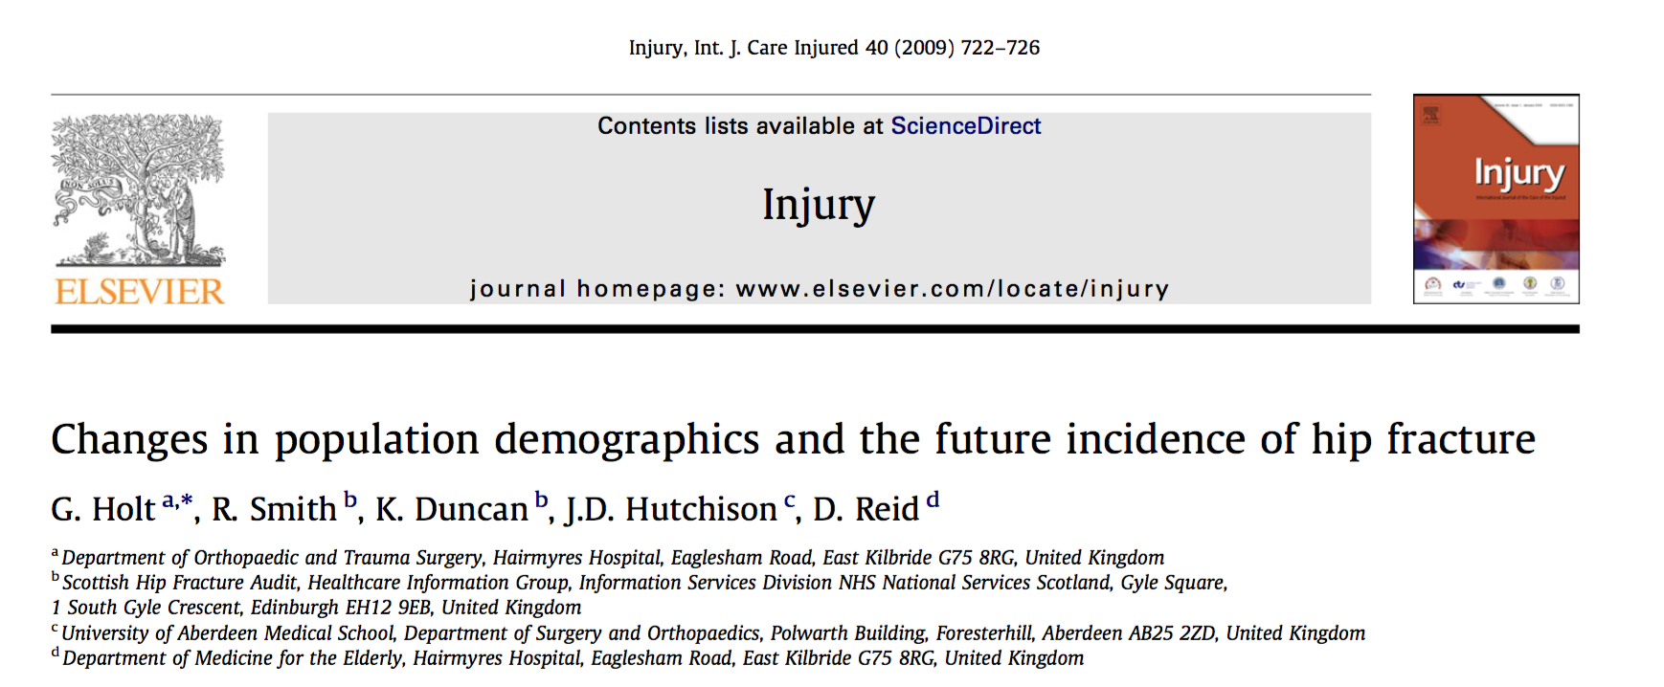

Slide 12
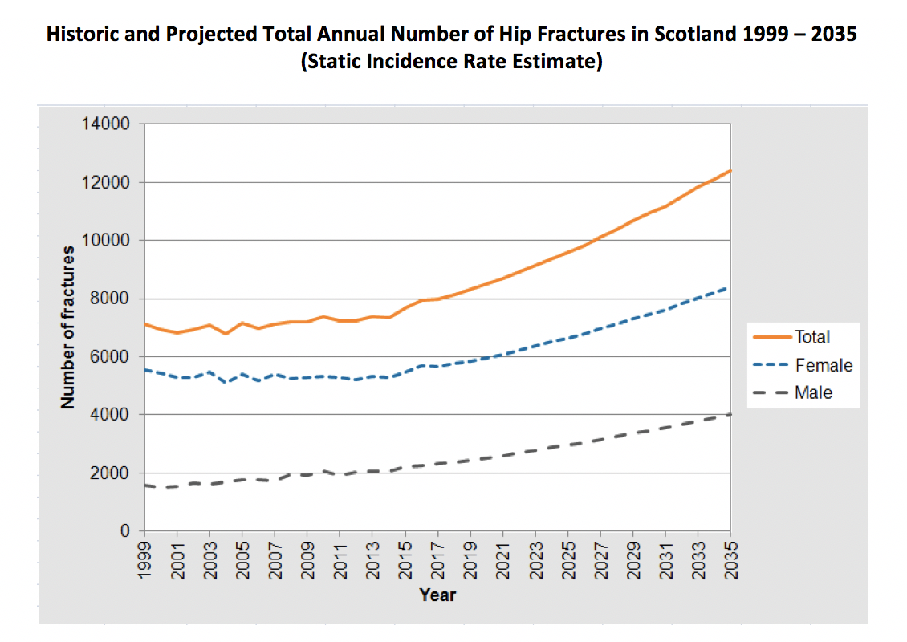
85 % increase

Slide 13
By 2035 - increase in the number of hip fractures by 85% from 1999 numbers.
Scotland increase from 7500 to 13 000 cases per annum.
By 2031 number of bed days will increase by 80%.
Requires an additional 475 hospital beds in Scotland – hospital the size of Crosshouse Hospital.
Cost increase from £200 million to £ 600 million.

Slide 14
Scotland was the first country in the world to have an evidence based guideline to treat hip fractures AND a prospective audit.
Started 1998.
Were a world leader in hip fracture care.

Slide 15
Notes:
But – are world leaders in hip fracture care.

Slide 16
In 2008 the audit was discontinued.
What was the effect?

Slide 17
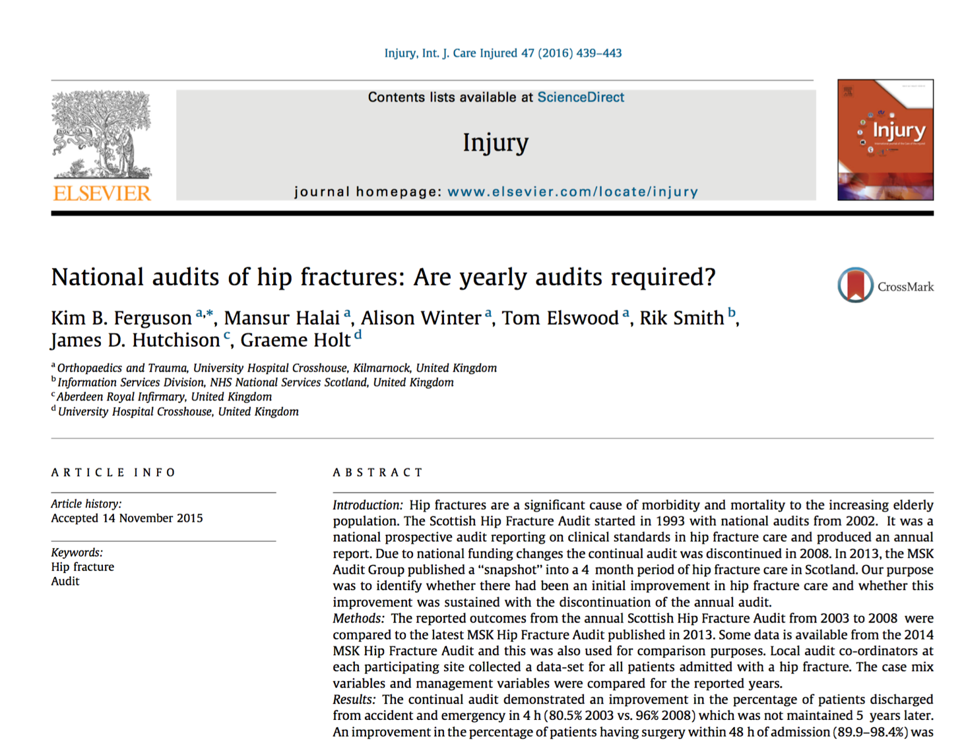

Slide 18
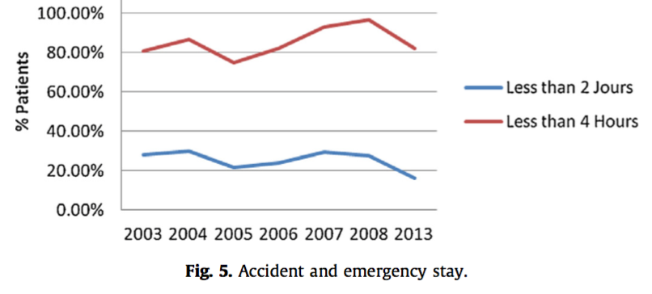
Time in Emergency Department

Slide 19
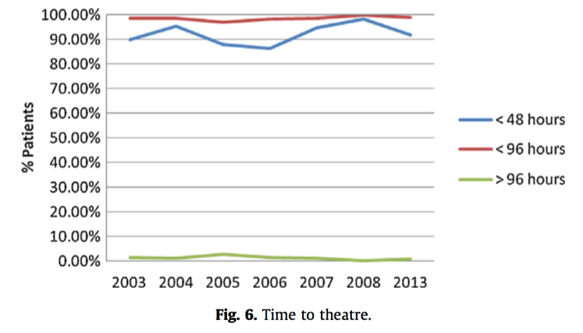
Time to Surgery

Slide 20
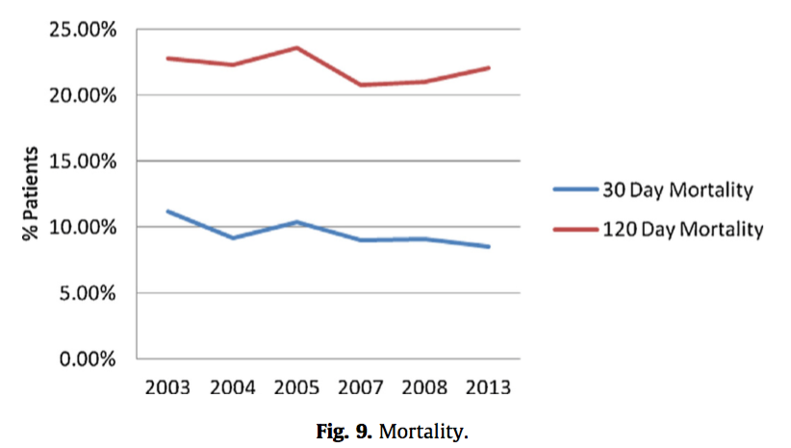
30/120 Day Mortality

Slide 21
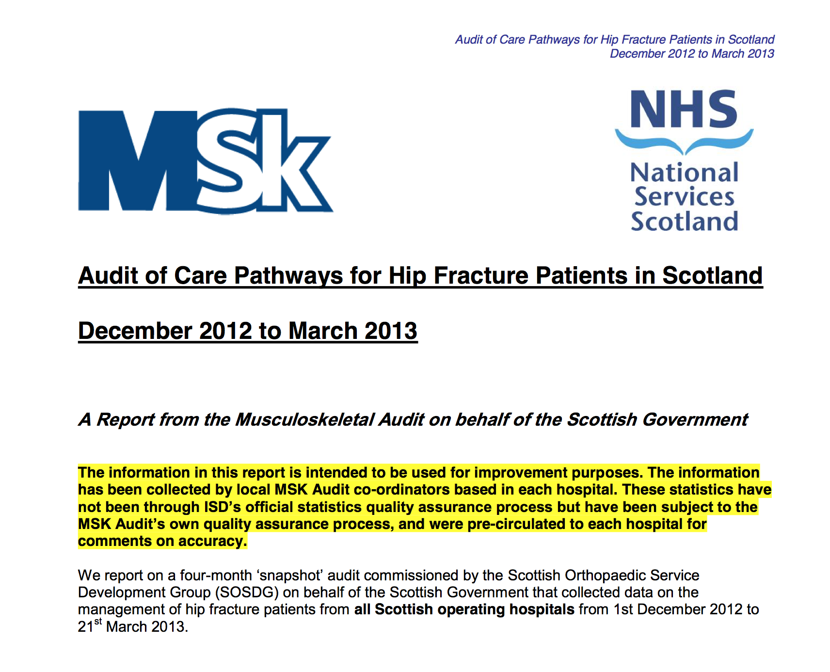

Slide 22
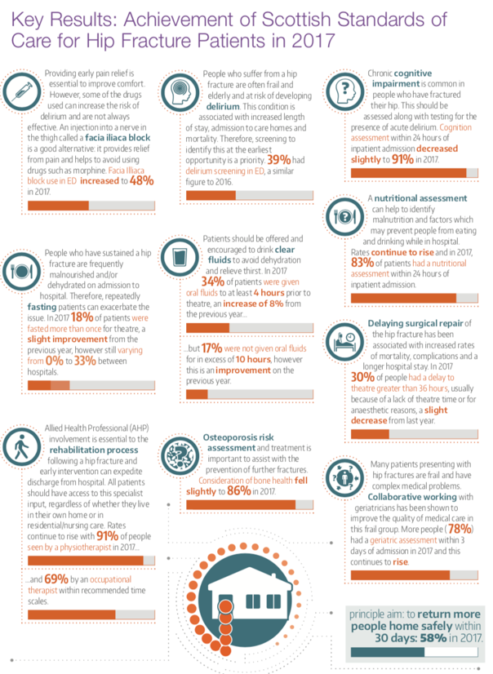
93% of all hip fractures in Scotland.

Slide 23
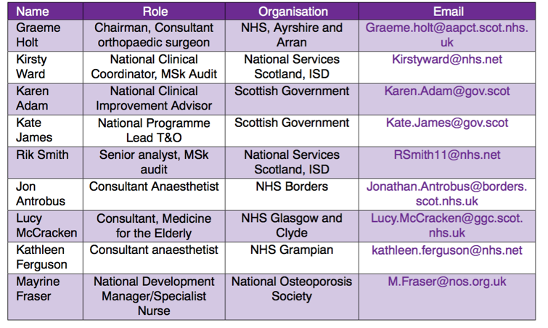
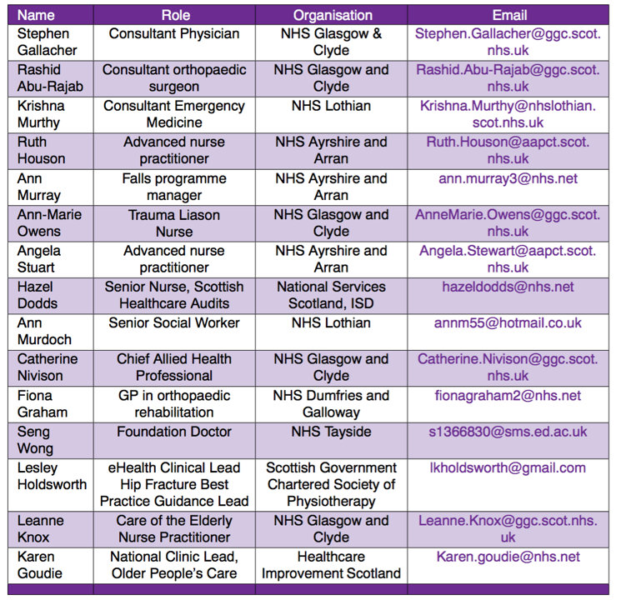
Multi-disciplinary Steering Group

Slide 24
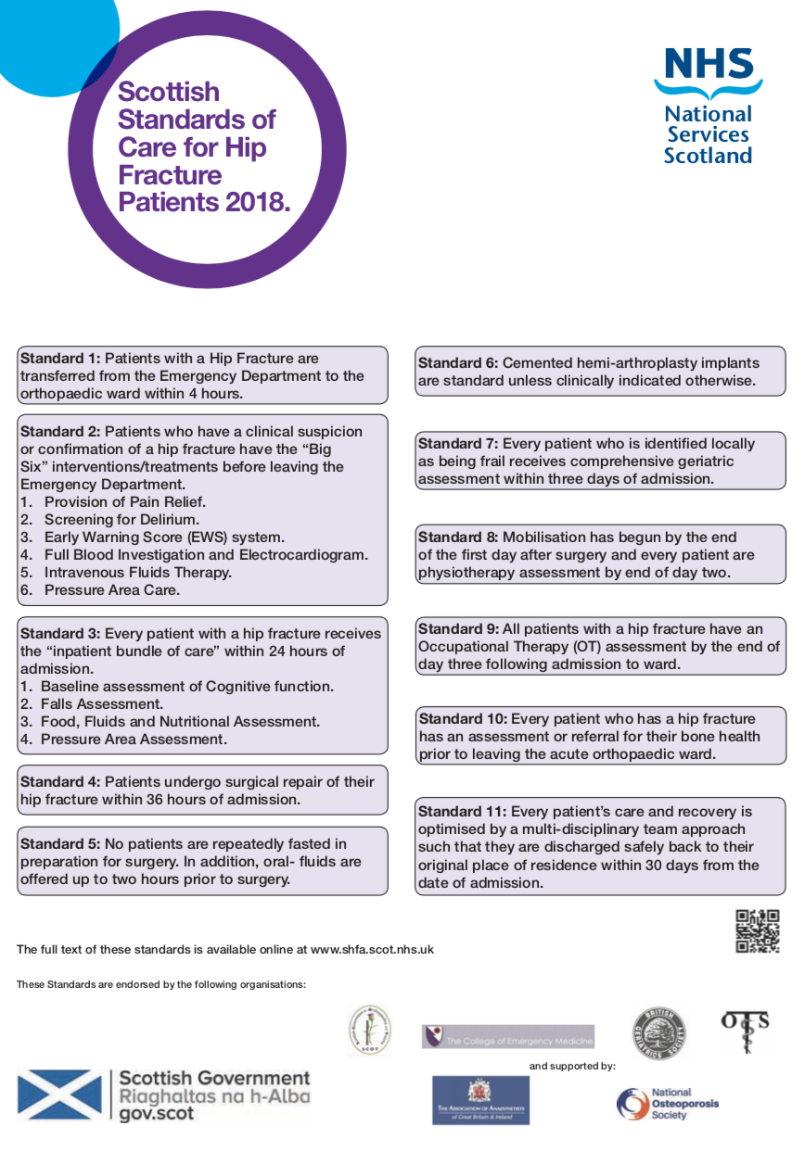
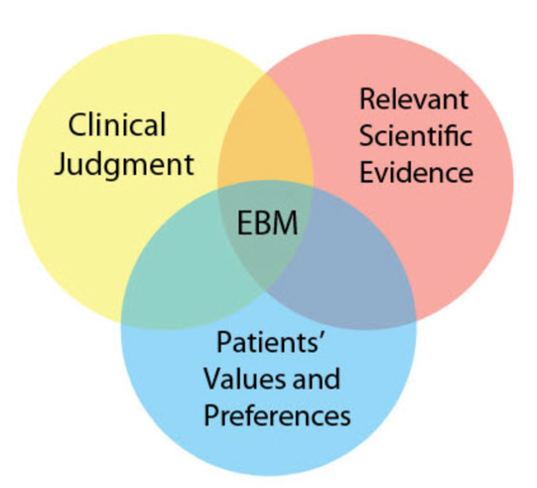

Slide 25
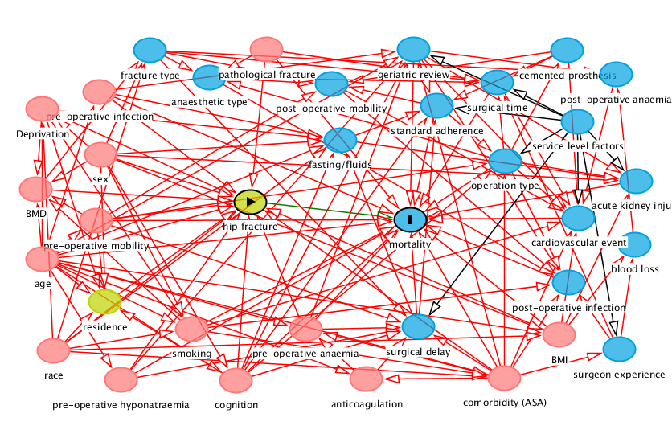
Mortality after hip fracture.

Slide 26
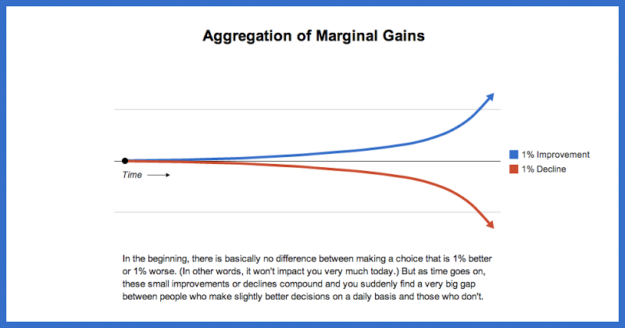
Marginal Gains

Slide 27
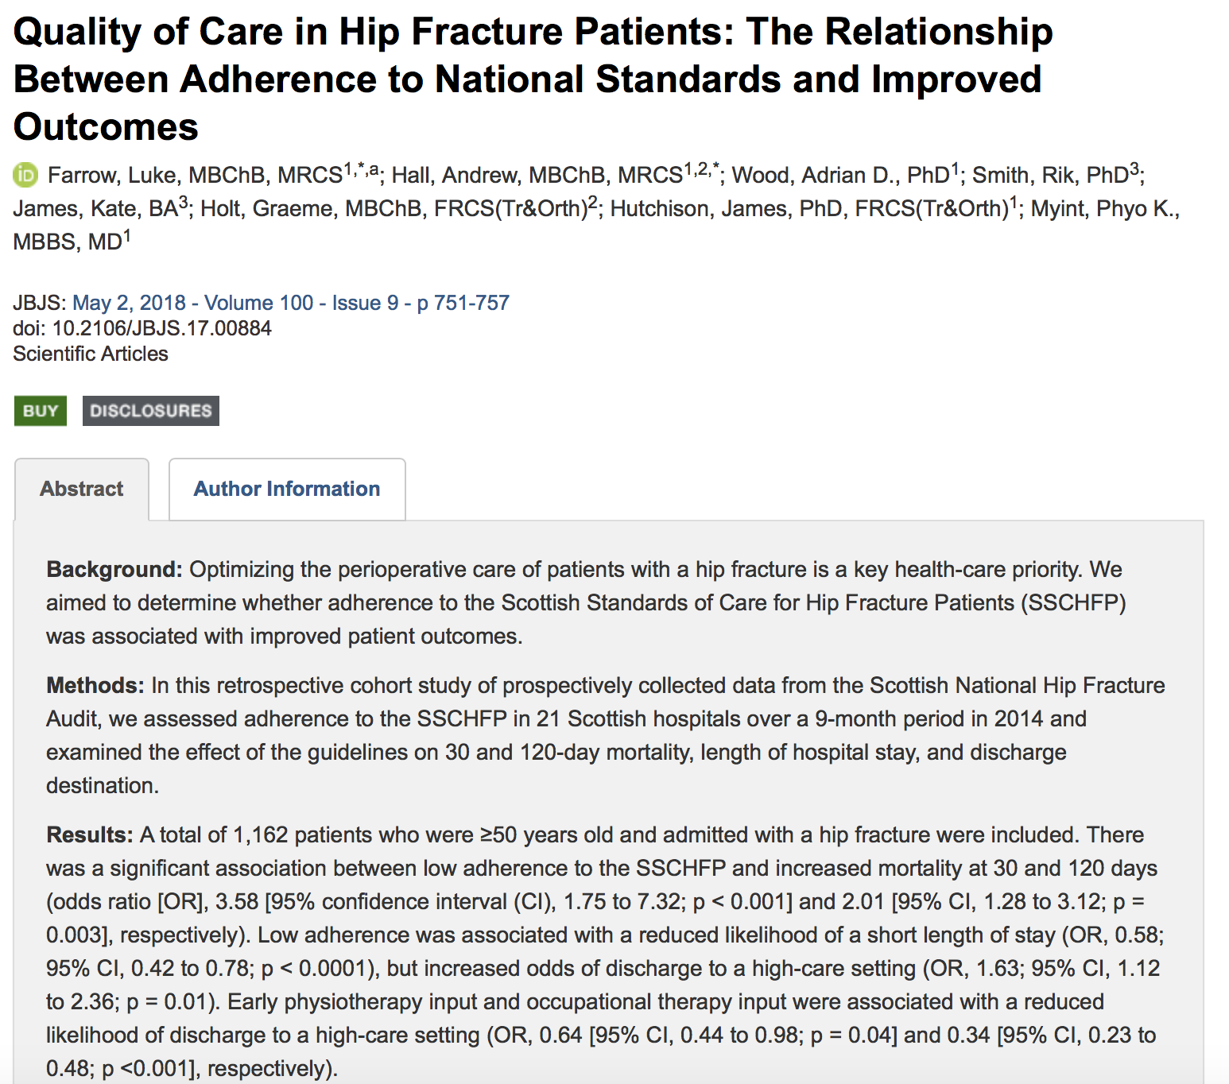

Slide 28
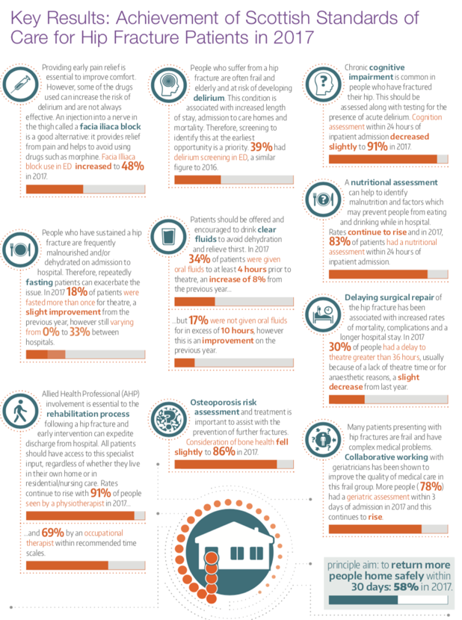
Annual Report

Slide 29
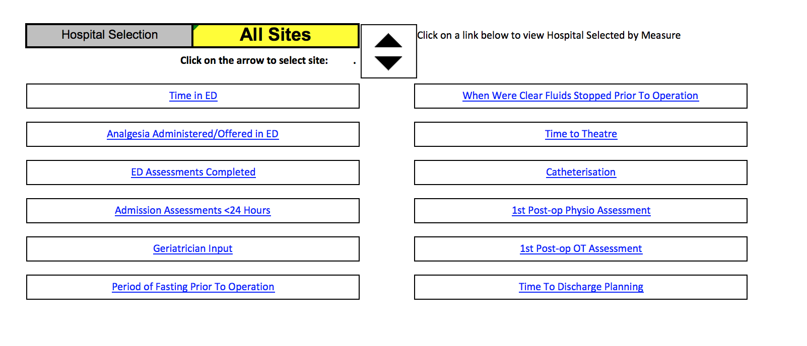
Realtime feedback

Slide 30
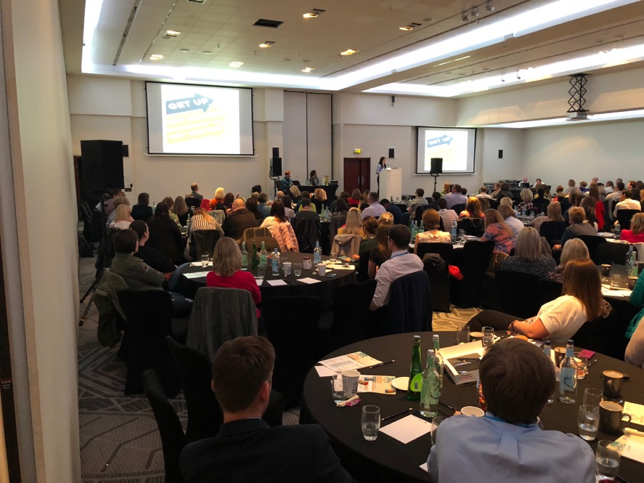

Slide 31
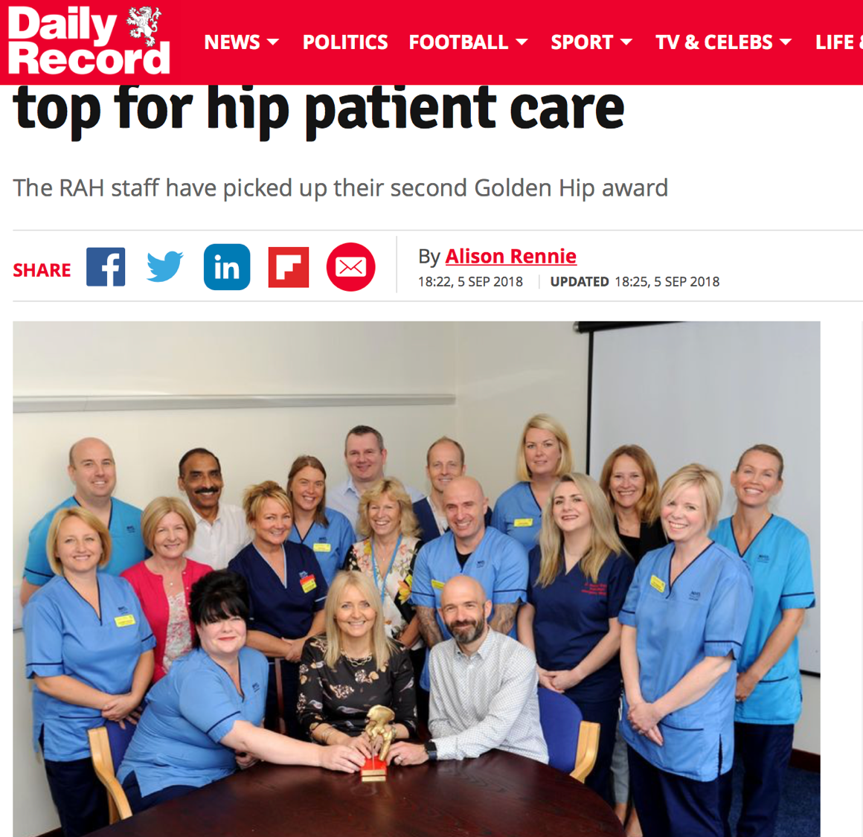

Slide 32
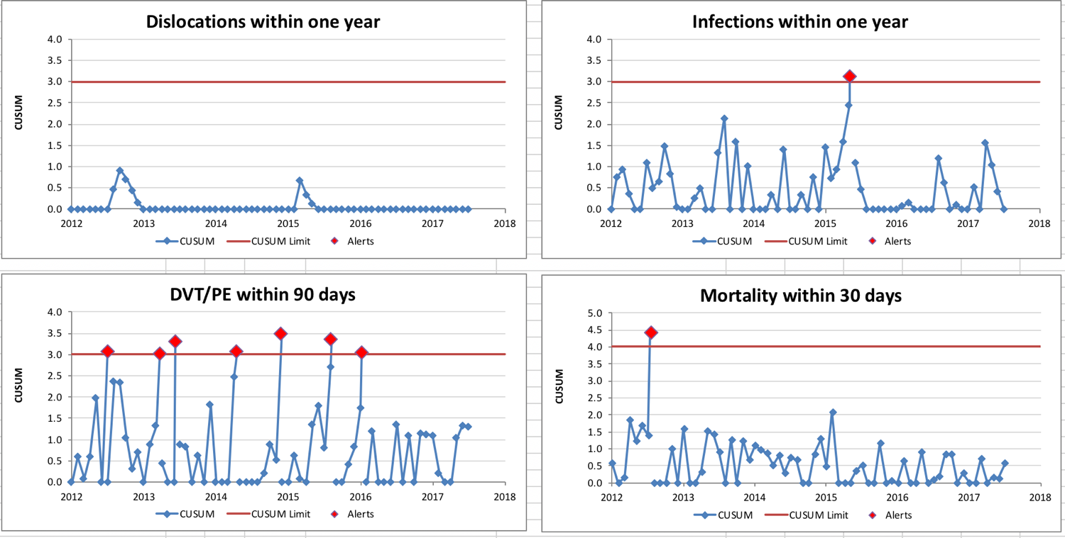
Complication Reporting/Outlier Identification

Slide 33
Website

Slide 34
Quarterly Spotlight

Slide 35
Patient Information

Slide 36
Are we making a difference?

Slide 37
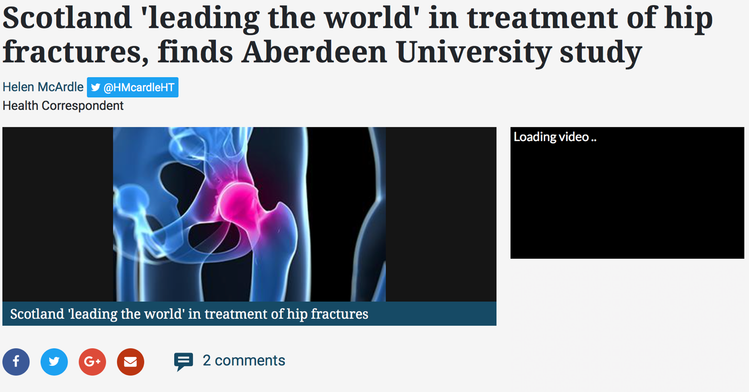

Slide 38
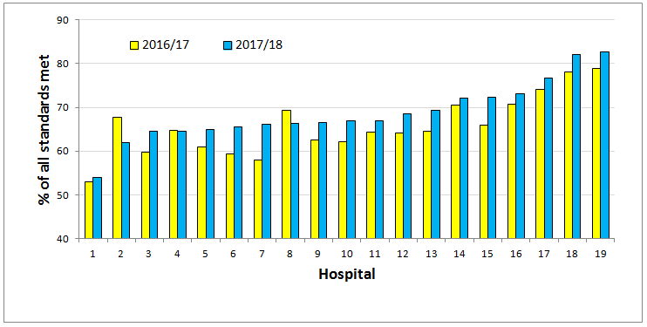
Cumulative achievement of standards

Slide 39
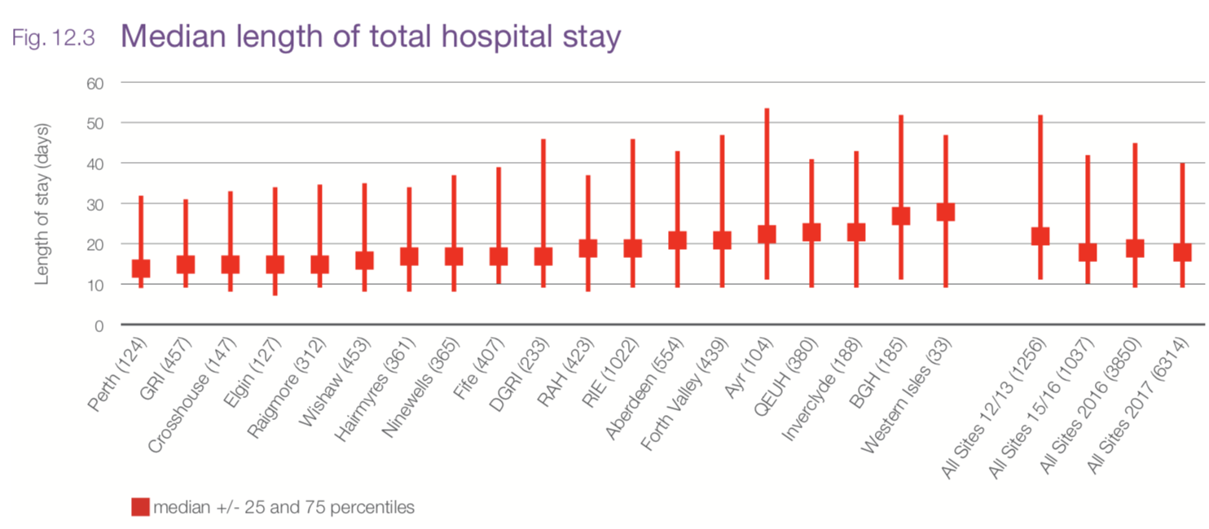
Median length of total hospital stay

Slide 40
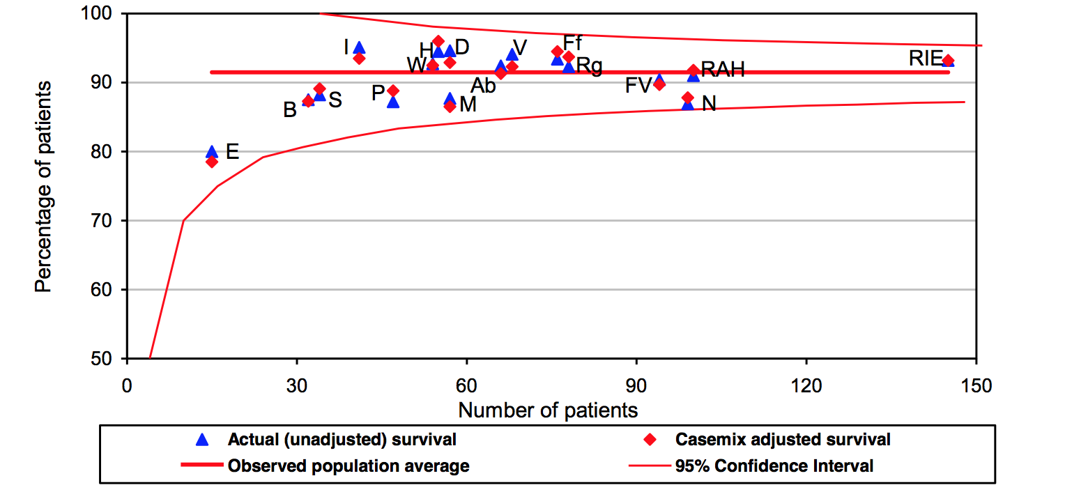
30 day survival - 2013

Slide 41
30 day mortality - 2016

Slide 42
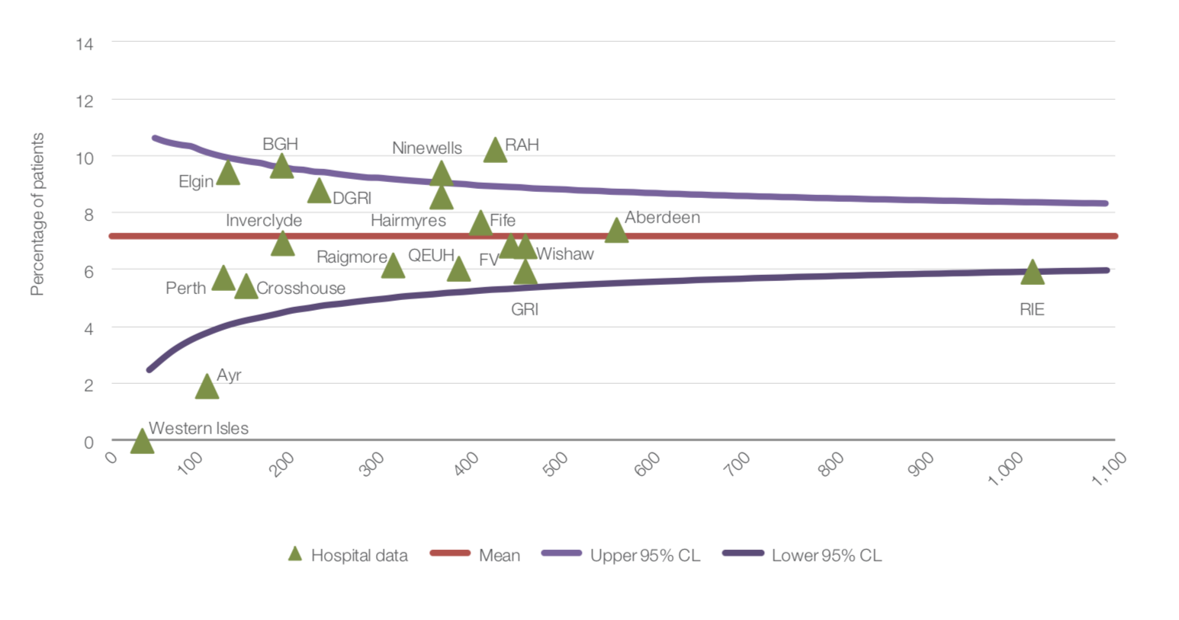
30 day mortality – 2017

Slide 43
Criterion | SHFA 2013 | SHFA 2017
4 hour ED transfer | 80% | 90%
Theatre within 36 hours | 65% | 71 %
Falls assessment | 70% | 97%
Cognitive assessment | 70% | 95%
Bone protection assessment | 60% | 90%
Physiotherapy by day 1 | 65% | 90%
Cemented hemi-arthroplasty | 70% | 90%
Mobilised by day 1 | 60% | 74%
CoE assessment 72 hours | 50% | 78%
Nutrition assessment | 70% | 84%
30 day original residence | 50% | 60%
Length of stay (overall) | 22 days | 18 days
30 day mortality | 9% | 7.1%

Slide 45
Criterion | SHFA 2013 | SHFA 2017 | NHFD
4 hour ED transfer | 80% | 90% | 40%
Theatre within 36 hours | 65% | 71 % | 70%
Falls assessment | 70% | 97% | 96%
Cognitive assessment | 70% | 95% | 94%
Bone protection assessment | 60% | 90% | 96%
Physiotherapy by day 1 | 65% | 90% | 94%
Cemented hemi-arthroplasty | 70% | 90% | 86%
Mobilised by day 1 | 60% | 74% | 77%
CoE assessment 72 hours | 50% | 78% | 89%
Nutrition assessment | 70% | 84% | 85%
30 day original residence | 50% | 60% | 67% (4 months)
Length of stay (overall) | 22 days | 18 days | 21 days
30 day mortality | 9% | 7.1% | 6.8%

Slide 46
Summary
LoS reduced from 22 days to 18 days (18%).
90 000 bed days saved over last 3 years
£45 million potential cost saving.
Mortality fallen by 22%.
150 lives per year saved.
Over 80% seen by CoE within 72 hours.
Continues to be unexplained variation in practice.

